Slide 1
2nd Conference on Nonlinearity, 18-22.October 2021, Belgrade, Serbia, SANN, SANS
The procedure of generating trajectory of motion of carrier conveyor for granular material in dependance of pod systems characteristics
Mirjana M. Filipovic
Mihajlo Pupin Institute, Volgina 15, Belgrade, University of Belgrade, Serbia. email: mirjana.filipovic@pupin.rs
Ljubinko B. Kevac
Innovation center of School of Electrical Engineering, Bulevar kralja Aleksandra 73, Belgrade University of Belgrade, Serbia. email: ljubinko.kevac@gmail.com

Slide 2
2nd Conference on Nonlinearity, 18-22.October 2021, Belgrade, Serbia, SANN, SANS
The aim of this research
is the analysis and synthesis of the motion of the transport system,
procedure for generating dynamic and kinematic model of the transport system,
how the choice of system parameters affects the motion of the vibratory trough

Slide 3
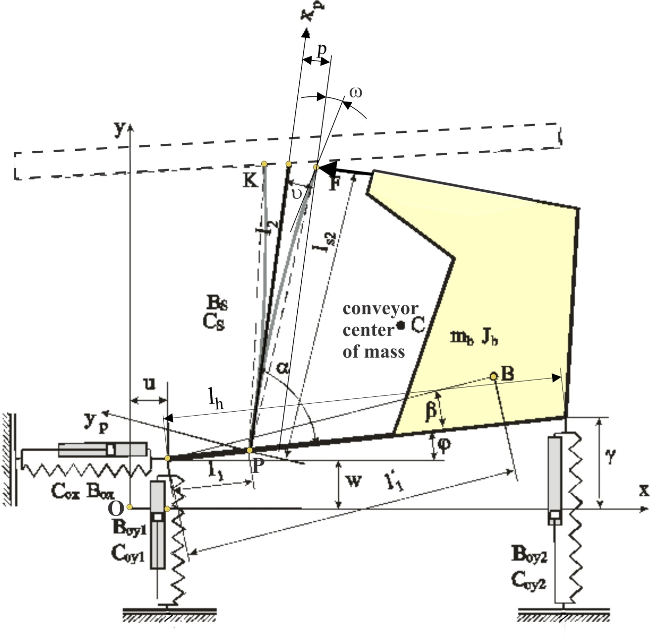
2nd Conference on Nonlinearity, 18-22.October 2021, Belgrade, Serbia, SANN, SANS
The Conveyor mechanism consists of two rigid bodies: the transporter’s base and vibratory trough. These two rigid bodies are connected by composite spring of known characteristics: C_{s} and B_{s}.
The base is linked to the foundation of the machine by one horizontal C_{ox}, B_{ox} and two vertical C_{oy1}, B_{oy1} and C_{oy2}, B_{oy2} damping-elastic elements of known characteristics. It is assumed that the masses, geometry, and the corresponding moments of inertia are known.
Fig. 1 Conveyor mechanism

Slide 4
2nd Conference on Nonlinearity, 18-22.October 2021, Belgrade, Serbia, SANN, SANS
In dependence of shape of motor force F, we have two different examples:
1. First example: The motor force F changes continuously during all time of working of transporter mechanism.
2. Second example: This case is composed of two phases which alternate precisely, programmatically. Motor force is dealing in infinite short period of time and after that follows the response of the system in finite period of time. These two stages are repeated cyclically.
a) The first stage: The impact force deal at a very short time interval. It's just one moment when the conveyor is exposed to the motor force. The action of force F is repeated cyclically with determined intensity. It must be emphasized that one of integral phenomenon of the dynamics of the conveyor motion is the impact of the collision. It's just one time moment when the conveyor is exposed to the motor force.
b) The second stage: The free motion of the transporter, immediately after the action of motor force. This is time period when the motor force is not working. In this time period F=0. This is essentially the response of the conveyor system over a period of time from the moment of the termination of force F until the moment it's re-effect on the system. This is the system response period of the conveyor system on influence of impact force.

Slide 5
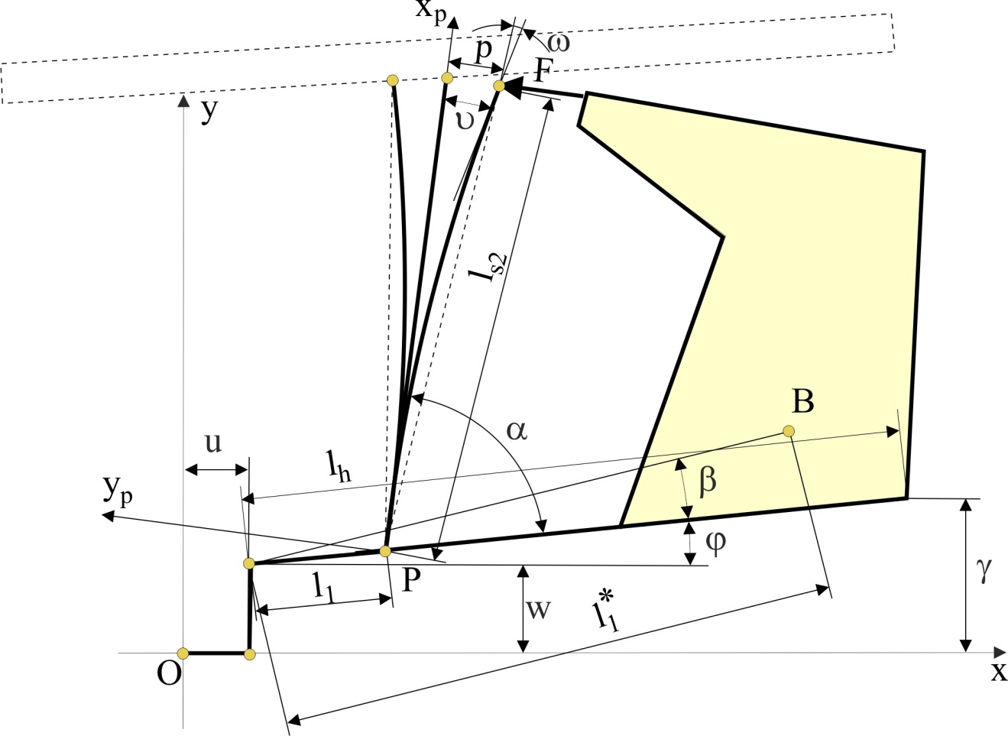
2nd Conference on Nonlinearity, 18-22.October 2021, Belgrade, Serbia, SANN, SANS
In order to make it easier to recognize geometric relations during the work of the conveyor mechanism we have formed Fig. 2, which is a bit simpler than Fig. 1.
Fig. 2. reveals the possibility that the conveyor mechanism is viewed as a robotic system. This is a novelty in the approach of the analysis and synthesis of the conveyor mechanism.
Fig. 2 Robotics configuration of Conveyors mechanism

Slide 6
2nd Conference on Nonlinearity, 18-22.October 2021, Belgrade, Serbia, SANN, SANS
Dynamic
We have deliberately chosen the generalized coordinates p/l_{2,} u, w, ϕ
Rotation angle of the tip of the composite spring is marked as ω and named Rayleigh’s angle. ω= ½ (p/l₂).
Potential and dissipative energy as result of elasticity of composite spring, potential and dissipative energy as result of elasticity of horizontal and vertical springs, kinetic and potential energy of the involved masses of the mechanism presented in Figs. 1 and 2, are defined. The equation of the motion of the considered system, obtained by applying Lagrange’s equations of second mode with respect to the first, second, third, and fourth generalized coordinates, p/l₂, u, w and ϕ, respectively:
(1)
(2)
(3)
(4)

Slide 7
2nd Conference on Nonlinearity, 18-22.October 2021, Belgrade, Serbia, SANN, SANS
Equations (1)-(4) that we should write in the matrix form obtain the mathematical model of the system depending on the selected generalized coordinates p/l₂, u, w and ϕ:
(5)
This is a mathematical model of a mechanism that is influenced by the force F of a motor that continuously works for a certain period of time.
(6)

Slide 8
2nd Conference on Nonlinearity, 18-22.October 2021, Belgrade, Serbia, SANN, SANS
The second example is more interesting. This case is composed of two phases which alternate, programmatically, in different time intervals. Motor force is dealing in infinite short period time and after that follows the response of the system for finite period time. These two stages are repeated cyclically.
In the analysis of this task, the impact of the collision must be emphasized as an integral phenomenon of the dynamics of the conveyor motion. It's just one moment when the conveyor is exposed to the motor force.
Because of that we applied model of collision for conveyor system. The model of system is integrated on eventually short impact interval Δt=t’’- t’. The moment t’ marks the beginning of collision and t’’ is the moment of the end of collision. Then the equations of system are obtained:
(7)
Or it can be written more simply in a simpler matrix form:
(8)

Slide 9
2nd Conference on Nonlinearity, 18-22.October 2021, Belgrade, Serbia, SANN, SANS
The collision was characterized by a sudden and rapid jump of velocity.
Th next phase is period when the conveyor belt is not influenced by the force of the motor F. This is essentially the response of the conveyor system over a period of time from the moment of the termination of force F until the moment it's re-effect on the system. The mathematical model of the conveyor mechanism for that system response period has the following form:
(9)
Or it can be written more simply in a simpler matrix form:
(10)

Slide 10
2nd Conference on Nonlinearity, 18-22.October 2021, Belgrade, Serbia, SANN, SANS
In following innovations in developed conveyor mechanism dynamic model, by equation (1)-(10), we can note:
- presence of Coriolis forces h in mathematical model of conveyor,
- coupling between the generalized coordinates, which is not expressed only through the inertial matrix H, but also can be seen through the Coriolis forces h.
- the motor force F that transmitted over the Jacobian matrix J not only to the motion of the generalized coordinate p/l₂, but also to the motion of the other three generalized coordinates u, w and ϕ.

Slide 11
2nd Conference on Nonlinearity, 18-22.October 2021, Belgrade, Serbia, SANN, SANS
Kinematics
Relationship between internal coordinates p/l₂, u, w, ϕ, ω and Cartesian, external, coordinates x_{k} y_{k} ψ_{k} was defined as so-called “direct kinematics”. Point K belongs to the tip of the composite spring to which the trough of the transport mechanism is attached.
In this case (see Fig. 1):
(11)
(12)
(13)
Where α∗=α+(p/l₂).
From equation (11)-(13) can be calculated
and
Relationship between external coordinates
and internal coordinates
are defined by equation :
(14)

Slide 12
2nd Conference on Nonlinearity, 18-22.October 2021, Belgrade, Serbia, SANN, SANS
Dynamic model of the system has been defined for four generalized coordinates p/l₂, u, w, ϕ; this means that in this interface, Jacobi matrix J will be formed as a connection between the velocity vector of the external coordinates , which defines the velocity of a point K of the conveyor carriers in the Cartesian coordinates, and the velocity vector of generalized coordinates :
(15)
The Jacobian matrix has the following form:
(16)

Slide 13
2nd Conference on Nonlinearity, 18-22.October 2021, Belgrade, Serbia, SANN, SANS
Therefore, the contribution in development of mathematical model in relation to the model is emphasized, for example, defined in [12] and [13] and main contribution are emphasized in Table 1:
 | characteristics |  | In this research | In research utill to day
1. | Matrix of inertia H | Coupling beetwen p/l₂ and ϕ | Exists | Not exist
 |  | Coupling beetwen u and p/l₂ | Not exist | Exists
 |  | Coupling beetwen u, and ϕ | Not exist | Exists
 |  | Coupling beetwen w and p/l₂ | Not exist | Exists
 |  | Coupling beetwen w and ϕ | Not exist | Exists
2. | Vector of Coriolis forces h |  | Exists | Not exist
3. | Gravity forces G, that cause static eror |  | Exists | Not exist
4. | Coupling beetwen u, and ϕ in rigidity matrix C and damping matrix B |  | Not exist | Exist
5. | Jacobi matrix |  | Exists | Not exist
6. | Generating of Cartesian coordinates, using method of “direct kinematics” problem |  | Exists | Not exist
7. | Rayleigh's angle ω |  | Exists | Not exist

Slide 14
2nd Conference on Nonlinearity, 18-22.October 2021, Belgrade, Serbia, SANN, SANS
Simulation Results
The first example is characterized by the impulse effect of the motor force only at the first time of the time selection F= 50000[N], see Fig. 3. And after that the motor force is F=0[N], i.e., it does not have the effect of the motor force and only the dynamics response of the mechanism of the transporter over the period of 5 [s] is observed
Fig 3. Motor force F, Example I.

Slide 15
2nd Conference on Nonlinearity, 18-22.October 2021, Belgrade, Serbia, SANN, SANS
Fig. 4. Elastic deformation of composite spring p, Example I.
Fig. 5. Elastic deformation of horizontal spring u, Example I.

Slide 16
2nd Conference on Nonlinearity, 18-22.October 2021, Belgrade, Serbia, SANN, SANS
Fig. 6. Elastic deformation of left vertical spring w, Example I.
Fig. 7. Angle of rotation of the conveyor base ϕ, Example I.

Slide 17
2nd Conference on Nonlinearity, 18-22.October 2021, Belgrade, Serbia, SANN, SANS
b) The second and third example are characterized by the impulse effect of the motor force F= 50000[N], which cyclically acts on the conveyor belt, see Fig. 8. And Fig. 9.
It's the frequency f= 27.78[Hz], while the selection period T= 0.036[s].
The above figure represents the observed size during the realization of the entire task for total time of T_{tot} = 5 [s].
II and III Examples are different only in one parameter, and because of that we can compare them.
The damping parameter in Example II is B_{s}=140[kg/s], but in Example III is B_{s}=70[kg/s]. The stiffness is the same for all three examples: C_{s}=1.0 e+006 [kg/s²], as well as all other parameters.
For selected characteristics of the system, the dynamics of the change of the elastic deformation of composite spring p, for Example II, presented in Fig. 10. To make it easier to compare Example II and Example III, the response images of the same quantities are placed side by side, so that the change of the elastic deformation of composite spring p, for Example III, presented in Fig. 11. We see that the change in the size of only one parameter, which is in example III, the dumping parameter Bs significantly affects the response dynamics of the conveyor mechanism.

Slide 18
2nd Conference on Nonlinearity, 18-22.October 2021, Belgrade, Serbia, SANN, SANS
The pictures below represent only the selected details from the upper images in a short time interval t = 4.7-5 [s]. It is just a separate detail of the observed size, for the period when the transition mode is completed and we only have a cyclic impact force.
Comparing Fig. 12 and Fig. 13 we see that elastic deformation of the composite spring p has a different nature of response in Example II compared to Example III. The statical error of the elastic deformation of the composite spring is p_{ster}≈-0.0007 [m] and by estimation it is identical both for Example II, and for Example III. The velocity of the change of this size of elastic deformation p, for Example II, III is given in Fig. 14, 15, respectively. It is noted that at the moment of action of the motor force we have a significant jump of speed p, the order of magnitude of 0.2 [m/s] for II Example, but for III Example we have jump of speed p, in the direction of the increment of the speed of motion of magnitude p so that this jump is not as big and not as noticeable as the jump in Example II. There is no jump in the position of this size. This is a logical consequence of influence of the impact force.
In the same way, we can analyze the dynamic responses of the elastic deformation of the horizontal spring u, of left vertical spring w, and angle of rotation of the conveyor base j.

Slide 19
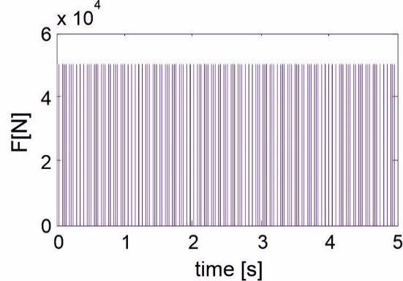
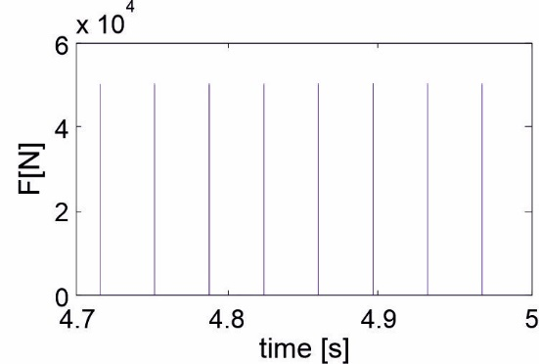
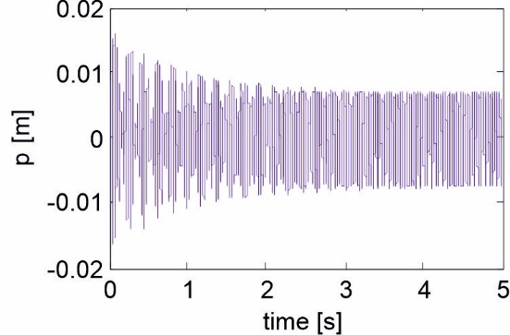
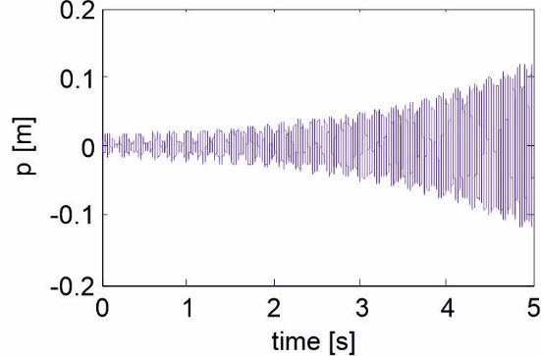
2nd Conference on Nonlinearity, 18-22.October 2021, Belgrade, Serbia, SANN, SANS
Fig. 8. Motor force F, for full time period, Example I and II, B_{s}=140[kg/s].
Fig. 9. Motor force F, for time period 4.7-5 [s], Example I and II, B_{s}=70[kg/s].
Fig. 10. Elastic deformation of composite spring p, Example II.
Fig. 11. Elastic deformation of composite spring p, Example III.

Slide 20
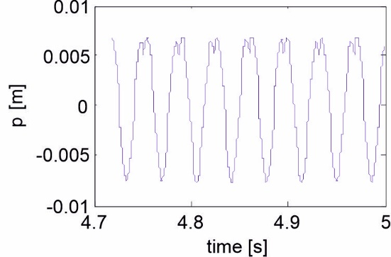
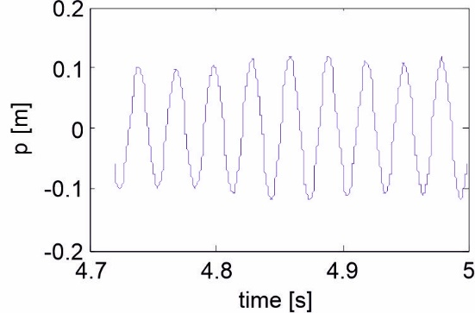
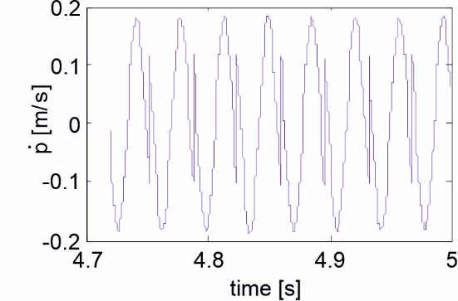
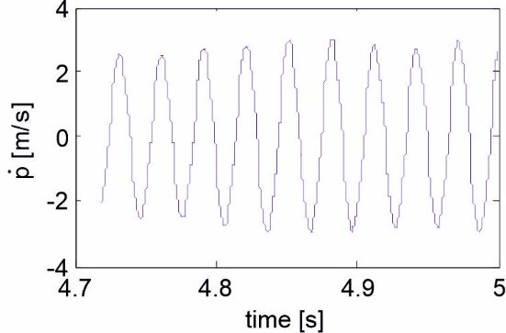
2nd Conference on Nonlinearity, 18-22.October 2021, Belgrade, Serbia, SANN, SANS
Fig. 12. Elastic deformation of composite spring p, for short time interval t = 4.7-5 [s], Example II.
Fig. 13. Elastic deformation of composite spring p, for short time interval t = 4.7-5 [s], Example III.
Fig. 14. Velocity of the change of elastic deformation of composite spring p, for short time interval t = 4.7-5 [s], Example II.
Fig. 15. Velocity of the change of elastic deformation of composite spring p, for short time interval t = 4.7-5 [s], Example III.

Slide 21
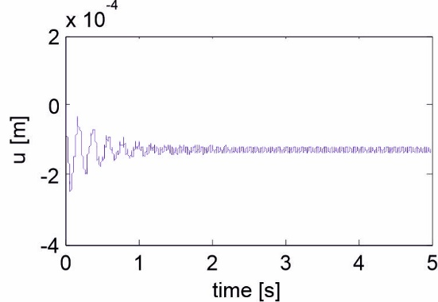
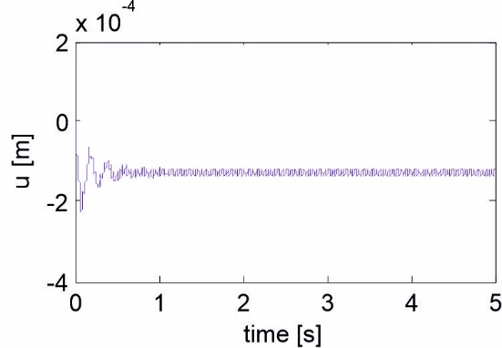
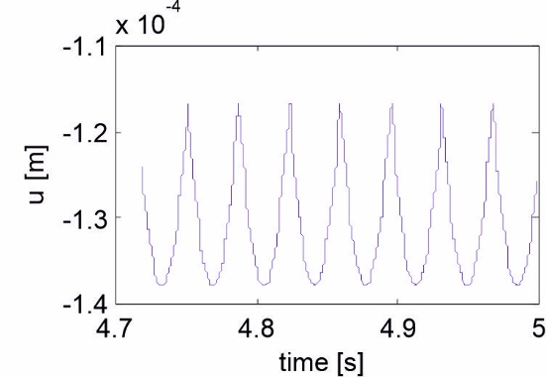
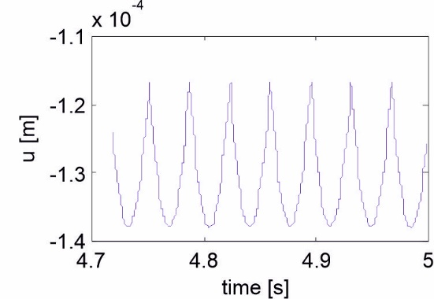
2nd Conference on Nonlinearity, 18-22.October 2021, Belgrade, Serbia, SANN, SANS
Fig. 16. Elastic deformation of horizontal spring u, Example II.
Fig. 17. Elastic deformation of horizontal spring u, Example III.
Fig. 18. Elastic deformation of horizontal spring u, for short time interval t = 4.7-5 [s], Example II.
Fig. 19. Elastic deformation of horizontal spring u, for short time interval t = 4.7-5 [s], Example III.

Slide 22
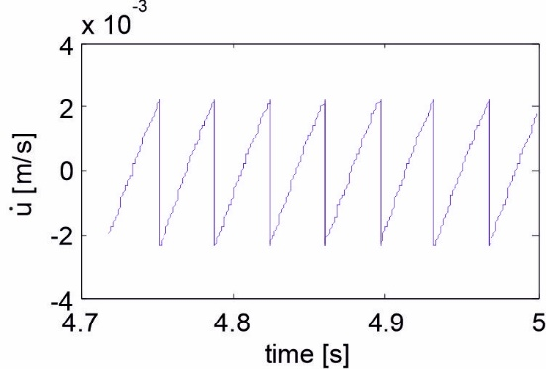
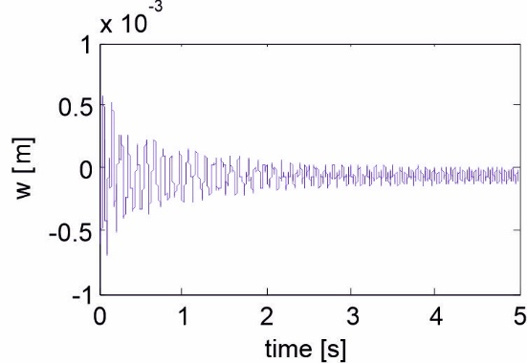
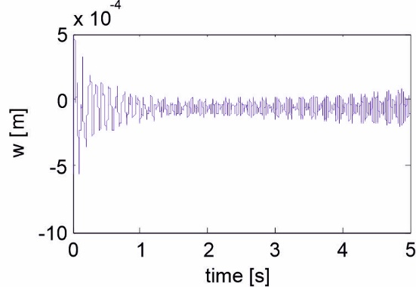
2nd Conference on Nonlinearity, 18-22.October 2021, Belgrade, Serbia, SANN, SANS
Fig. 20. Velocity of the change of elastic deformation of horizontal spring u, for short time interval t = 4.7-5 [s], Example II.
Fig. 21. Velocity of the change of elastic deformation of horizontal spring u, for short time interval t = 4.7-5 [s], Example III.
Fig. 22. Elastic deformation of left vertical spring w, Example II.
Fig. 23. . Elastic deformation of left vertical spring w, Example III.

Slide 23
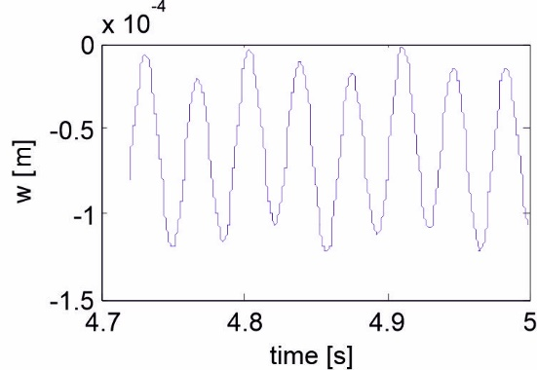
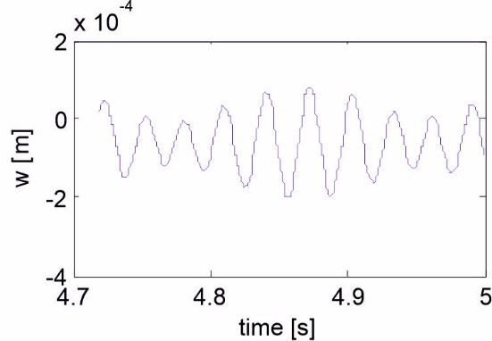
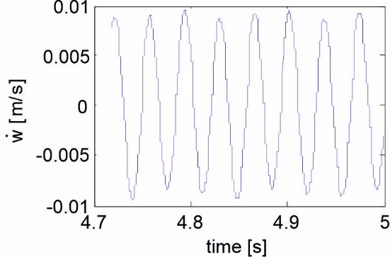
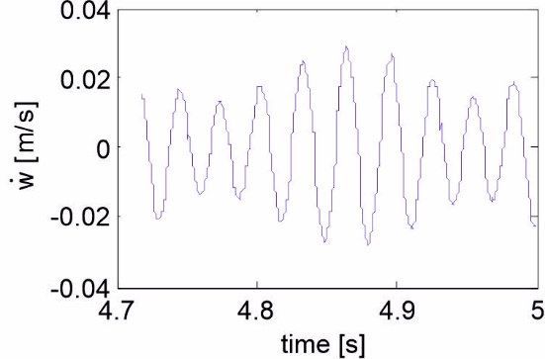
2nd Conference on Nonlinearity, 18-22.October 2021, Belgrade, Serbia, SANN, SANS
Fig. 24. Elastic deformation of left vertical spring w, for short time interval t = 4.7-5 [s], Example II.
Fig. 25. Elastic deformation of left vertical spring w, for short time interval t = 4.7-5 [s], Example III.
Fig. 26. Velocity of the change of elastic deformation of left vertical spring w, for short time interval t = 4.7-5 [s], Example II.
Fig. 27. Velocity of the change of elastic deformation of left vertical spring w, for short time interval t = 4.7-5 [s], Example III.

Slide 24
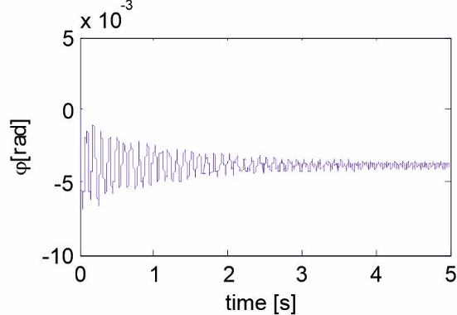
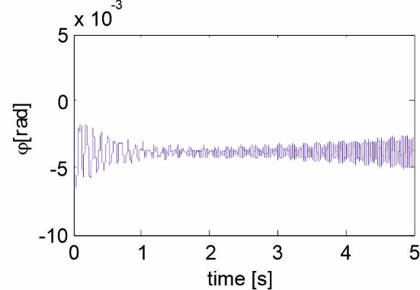
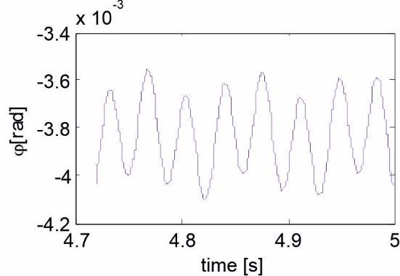
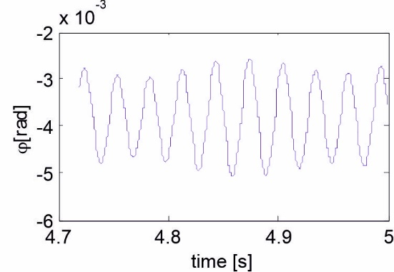
2nd Conference on Nonlinearity, 18-22.October 2021, Belgrade, Serbia, SANN, SANS
Fig. 28. Angle of rotation of the conveyor base ϕ, Example II.
Fig. 29. Angle of rotation of the conveyor base ϕ, Example III.
Fig. 30. Angle of rotation of the conveyor base j, for short time interval t = 4.7-5 [s], Example II.
Fig. 31. Angle of rotation of the conveyor base j, for short time interval t = 4.7-5 [s], Example III.

Slide 25
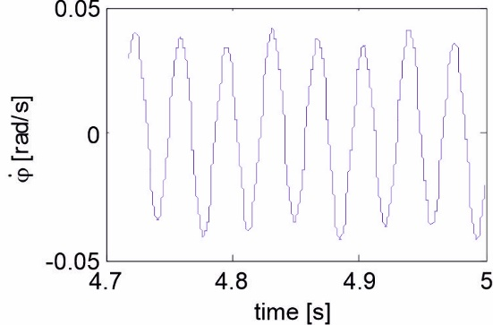
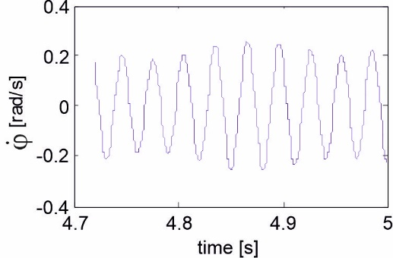
2nd Conference on Nonlinearity, 18-22.October 2021, Belgrade, Serbia, SANN, SANS
Fig. 32. Velocity of the change of angle of rotation of the conveyor base ϕ, for short time interval t = 4.7-5 [s], Example II.
Fig. 33. Velocity of the change of angle of rotation of the conveyor base ϕ, for short time interval t = 4.7-5 [s], Example III.
All four generalized coordinates p/l₂, u, w, ϕ, and their velocities:
are used in kinematic relations to be calculate external coordinates x_{k} and y_{k}, and their velocities, also. The x_{k} and y_{k} are coordinate of tip of composite spring in point K, in x-y plane. The motion (motion velocity) of point K of composite spring is presented in Fig. 34 (Fig. 36), for II Example in a short time interval t = 4.7-5 [s]. We can see that motion (motion velocity) of point K oscillatory, cyclically and that is rhythmically repeating. When we analyze motion (motion velocity) of point K for Example III, in Fig. 35 (Fig. 37), for a same time interval t = 4.7-5 [s], we can see different motion comparing with Example II.

Slide 26
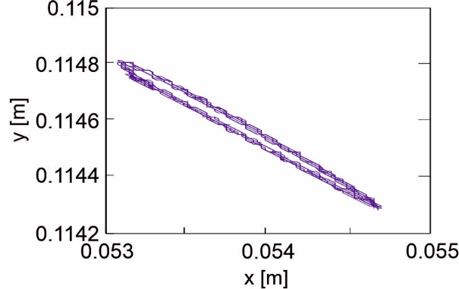
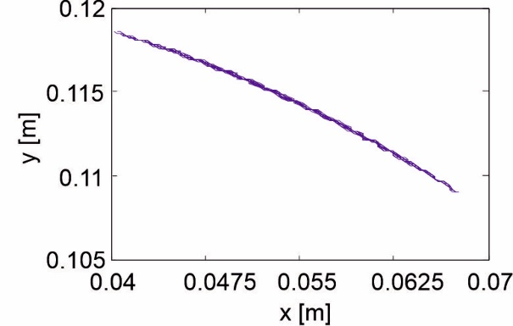
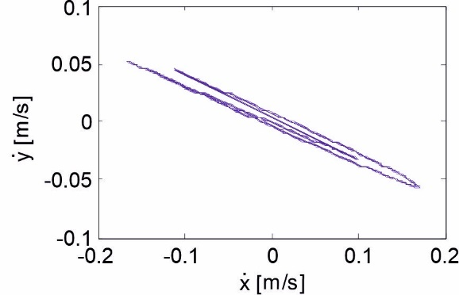
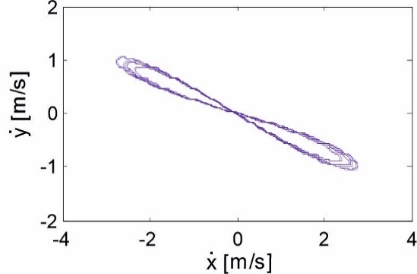
2nd Conference on Nonlinearity, 18-22.October 2021, Belgrade, Serbia, SANN, SANS
Fig. 34. Motion of point K of carrier of conveyor in x-y plane, Example II.
Fig. 35. Motion of point K of carrier of conveyor in x-y plane, Example III.
Fig. 36. Velocity of the change of motion of point K of carrier of conveyor in x-y plane, Example II.
Fig. 37. Velocity of the change of motion of point K of carrier of conveyor in x-y plane, Example III.

Slide 27
2nd Conference on Nonlinearity, 18-22.October 2021, Belgrade, Serbia, SANN, SANS
Conclusion
Three mathematical models of the system are defined when:
1. the motor force works continual in the finite time interval,
2. when the motor force works at small time interval,
3. conveyor mechanism is working without motor force; this model shows the dynamics of the response of the system after the impact of the motor force.
If we choose the motor force to be impulse and needs to be repeating rhythmically, the work of the conveyor mechanism defines the model 2 and the model 3 that are cyclically and in the same order repetitive. In model 2, the phenomenon of collision is defined, and this is the moment when the motor hits the trough with force F, at small time period. Influence of the current force F is special phenomenon, which has own legality. At the moment of collision, the motor force does not only work on the elastic deformation of composite spring, coordinate p direction, but it also transmits and acts on other generalized coordinates, also, via Jacobi’s matrix. At the moment after impact act of the motor force on the vibratory conveyor, then the dynamics of the behavior of the system is different and it is mathematically formulated by the model 3.

Slide 28
2nd Conference on Nonlinearity, 18-22.October 2021, Belgrade, Serbia, SANN, SANS
A comparative analysis of this model was made with the so far known models in this field.
Different structure of inertia matrix H, different coupling between the generalized coordinates, through the inertial matrix H,
presence of Coriolis forces h in dynamical model of conveyor,
presence of Gravity forces G in dynamical model of conveyor,
different coupling between the generalized coordinates, through the matrix of rigidity C and matrix of damping B,
the motor force F that transmitted over the Jacobian matrix J to the motion of all four generalized coordinates p/l₂, u, w and ϕ,
the kinematics model of such a mechanism is defined, which is a prerequisite for the correct definition of a dynamic model,
the Rayleigh's angle ω are introduced as real characteristic of composite spring.
The possibility of change of trajectory motion of point K opens new research view in this area, where we have possibility to planning the trajectory and velocity of the transport material and thus its flow, changing of conveyor components characteristics. This result is new and original, in relation to the solutions known so far.

Slide 29
2nd Conference on Nonlinearity, 18-22.October 2021, Belgrade, Serbia, SANN, SANS
References
Filipović, M., Vukobratović, M.: Modeling of Flexible Robotic Systems, Computer as a Tool, EUROCON 2005, The International Conference, Belgrade, Serbia and Montenegro, 2, pp. 1196 - 1199, Nov. 2005.
Filipović ,M., Vukobratović, M.: Contribution to modeling of elastic robotic systems, Engineering & Automation Problems, International Journal, 5(1) pp. 22-35, 2006.
Filipović, M., Vukobratović, M.: Complement of Source Equation of Elastic Line, Journal of Intelligent & Robotic Systems, International Journal, 52(2) pp. 233 – 261, June 2008.
Filipović, M., Vukobratović, M.: Expansion of source equation of elastic line, Robotica, International Journal, 26(6) pp. 739-751, November 2008.
Filipović, M.: Relation between Euler-Bernoulli Equation and Contemporary Knowledge in Robotics, Robotica, International Journal, Cambridge University Press, Vol. 30, No. 1, pp. 1-13, 2012.
Chumenko, V. N., Yuschenko, A. S., Impact Effects Upon Manipulation Robot Mechanism (in Russian), Technical cybernetics, No 4, 1981.
Keller, J. B., Impact with Friction, Journal of Applied Mechanics, Vol. 29/1-29/4, 1986.
Stronge W. J., Rigid Body Collision with Friction, Proc. R. Soc. Lond. A., 429, pp. 169-181, 1990.
Hurmuzlu, Y., Marghitu, D. B., Rigid Body Collision of Planar Kinematic Chain with Multiple Contact Points , Intl. J. of Robotic Research, 13(1) pp. 82-92, 1994.
Tornambe, A., Modeling and Controlling Two-Degrees- of-Freedom Impacts, Proc. 3rd IEEE Mediterranean Conf. On Control and Automation, Lymassol, Cyprus, 1995.
Filipović, M., Elastic Robotic System with Analysis of Collision and Jamming , 7th International Symposium on Intelligent Systems and Informatics - SISY 2009, Subotica, Serbia (25-26 September 2009).
T. Doi , K. Yoshida , Y. Tamai , K. Kono , K. Naito , T. Ono , Modelling and feedback control for vibratory feeder of electromagnetic type, J. Robot. Mechatron. 11 (5) (1999) 563–572 .
Despotovic Z, Urukalo Dj., Lecic M., Cosic A., Mathematical modeling of resonant linear vibratory conveyor with electromagnetic excitation: simulations and experimental results, Applied Mathematical Modelling,41, pp. 1–24, 2017.
Lord Rayleigh, Theory of Sound, second publish, paragraph 186, 1894-1896.

