Slide 1

MASS MINIMIZATION OF AN AFG TIMOSHENKO BEAM WITH A COUPLED AXIAL AND BENDING VIBRATIONS
Aleksandar M. Obradović , PhD, Professor
University of Belgrade, Faculty of Mechanical Engineering
Corresponding member of
Serbian Academy of Nonlinear Sciences ( SANS )
Belgrade, October 2021

Slide 2
Abstract:
Shape optimization (mass minimization)of an axially functionally graded (AFG) Timoshenko beams.
Specified fundamental frequency.
Coupled axial and bending vibrations, where contour conditions are the cause of coupling.
Pontryagin’s maximum principle, with the beam cross-sectional area being taken for control.
Cross-sectional area is limited.
Property of self-adjoint systems is employed, where all adjoint variables are expressed by state variables.
Shooting method is applied to solving TPBVP.
Different case of contour conditions at the beam ends.
Percent saving of the beam mass is determined, compared to the beam of a constant cross-section.

Slide 3
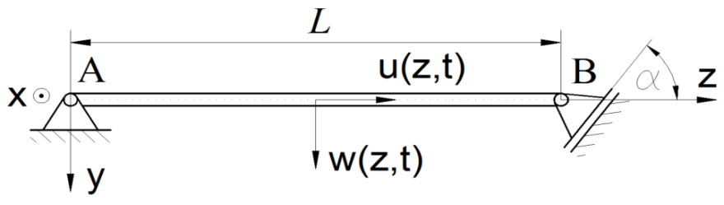
Obradović A, Šalinić S, Grbović A., Mass minimization of an Euler-Bernoulli beam with coupled bending and axial vibrations at prescribed fundamental frequency, Engineering Structures, Vol. 228, 111538, 2021.
Case of complex boundary conditions that lead to the coupling between axial and bending vibrations, although the differential equations themselves are not mutually coupled.
Homogeneous material; Euler-Bernoulli beams
An inequality constraint is imposed to the beam diameter derivative ( slope)
Pontryagin’s maximum principle is used in this paper, which is reduced to the two-point boundary value problem of the system of ordinary differential equations
Costate vector coordinates are expressed via state quantities using the scalar parameter p;
This has been noted in the shape optimization problems reported by Atanacković et al. and has facilitated the application of Pontryagin’s maximum principle.

Slide 4
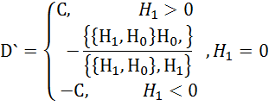


Obradović A, Šalinić S, Grbović A., Mass minimization of an Euler-Bernoulli beam with coupled bending and axial vibrations at prescribed fundamental frequency, Engineering Structures, Vol. 228, 111538, 2021.
Solution of Pontryagin’s maximum principle (α= π/4, f=100 Hz)
R= 0.0252811 m
Black, C unconstrained
Blue, C=0.2
Red, C=0.1
Green, C=0.0171595

Slide 5
Introduction
In this paper:
Case of applying axially functionally graded ( AFG ) materials, where the material characteristics such as density, Young’s modulus of elasticity and the shear modulus change along the beam axis
Constrained cross section area
Timoshenko beam model used

Slide 6
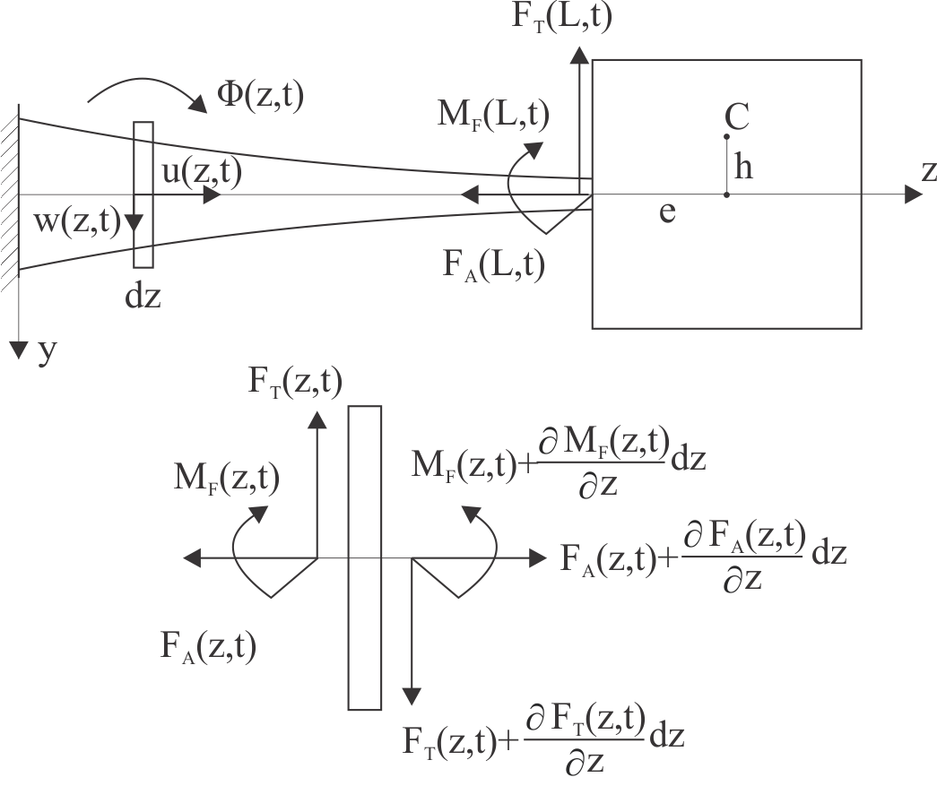
Problem formulation
The Timoshenko cantilever beam: length L, variable cross-sectional area and axial moment of inertia, AFG material, the density , Young’s modulus of elasticity and the shear modulus , are variable along the beam axis. At the right end a body of mass M and moment of inertia is fixed eccentrically to the central axis, where the position of the center of mass is defined by quantities e and h.
Optimization problem, to be considered in this paper, includes defining the function of change of the cross-sectional area that will lead to the Timoshenko cantilever beam mass minimization, where the fundamental frequency is specified. In that regard, the functional that is minimized has the form:

Slide 7
Differential equations of Timoshenko beams
The axial force:
The bending moment:
The slope angle of the elastic line:

Slide 8
Separation of variables
State equations:

Slide 9
General case of contour conditions
Results of this research is applicable in general case of contour conditions

Slide 10
Contour conditions
Left end
Right end

Slide 11
Shape optimization by applying Pontryagin’s maximum principle
Pontryagin’s function:
Coupled system of equations:

Slide 12
Shape optimization of a cantilever beam by applying Pontryagin’s maximum principle
Additional state quantity Z such that
Transversality conditions
Variation dependencies at the left/right end:

Slide 13
Shape optimization of a cantilever beam by applying Pontryagin’s maximum principle
Transversality conditions
Costate vector coordinates are expressed via state quantities using the scalar parameter p
Also:

Slide 14
Shape optimization of a cantilever beam by applying Pontryagin’s maximum principle
Differential equations of the coupled system are reduced to the governing system.
Transversaility conditions are satisfied in the case when the conditions at the left end and at the right end are satisfied.
The coupled system and conditions of transversality are excluded from further solving, which doubles the number of differential equations and missing initial conditions.
Atanackovic T., Glavardanov V., Optimal shape of a heavy compressed column, Structural and Multidisciplinary Optimization, Vol. 28, 388-396, 2004.
Atanackovic T., Optimal shape of column with own weight: bi and single modal optimization, Meccanica, Vol. 41, 173–196, 2006.
Atanackovic T., Seyranian A., Application of Pontryagin’s principle to bimodal optimization problems, Structural and Multidisciplinary Optimization, Vol. 37, 1-12, 2008.

Slide 15
Shape optimization of a cantilever beam by applying Pontryagin’s maximum principle
Optimal controls are defined from the maximum condition of Pontryagin’s function.
Reduced

Slide 16
Shape optimization of a cantilever beam by applying Pontryagin’s maximum principle
It can be taken that
Three-parameter shooting
If numerical solving is performed in the program package WolframMathematica using function NDSolve[…], it is not necessary to express A(z) in analytical form via state quantity, because this function contains in itself the procedure for numerical solving of the system of differential and ordinary equations.

Slide 17
Numerical example
The shape optimization procedure will be presented using the example of a cantilever beam of a square cross-section , length L=1m , with a rigid body placed eccentrically at the free end.
Obradović A., Šalinić S., Tomović A., Free vibration of axially functionally graded timoshenko cantilever beam with a large rigid body attached at its free end, 8th International Serbian Congress on Theoretical and Applied Mechanics, Serbian Society of Mechanics, Kragujevac, Serbia, 28.-30. Jun, 2021.

Slide 18
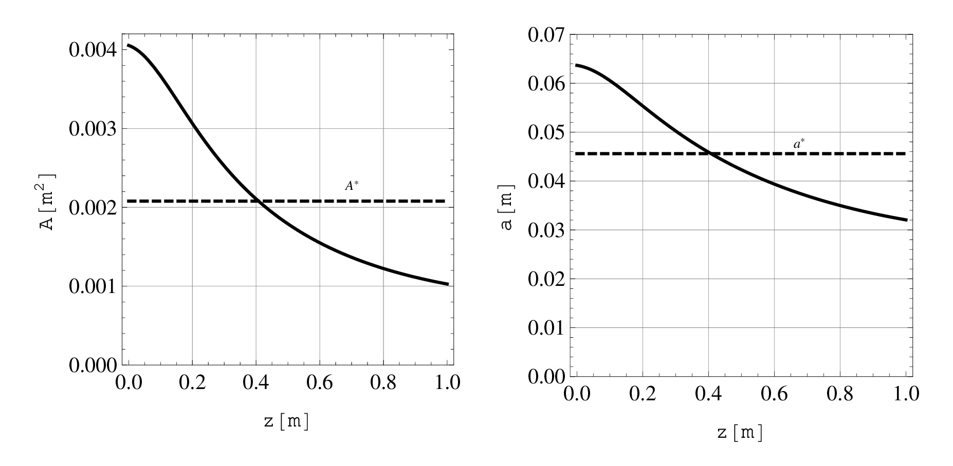
Numerical example
A three-parameter shooting

Slide 19
Numerical example
Relative material saving compared to the cantilever beam of a constant cross-section corresponding to the same circular frequency amounts to:

Slide 20
Numerical example
Case of limitted cros sectional area

Slide 21
Numerical example
Five-parameter shooting:

Slide 22
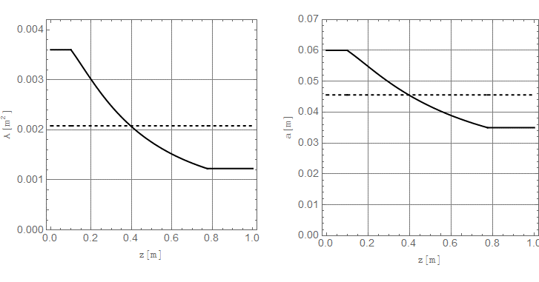
Numerical example
Five-parameter shooting ( )

Slide 23
Conclusions
This paper demonstrates the performance of shape optimization of AFG Timoshenko beam of a square cross-section with coupled axial and bending vibrations, where the cantilever beam mass minimization is done at specified fundamental frequency.
In solving this optimization problem Pontryagin's maximum principle is applied. So far, Pontryagin’s maximum principle has been practically used for solving optimization problems in buckling so that in this paper its application is extended to optimization problems in oscillating body.
The above procedure can be also applied to another case off cross section such as cirkular et all
The above procedure can be also applied to another case of contour conditions at the beam ends, including bodies eccentrically positioned at both ends, different types of supports at beam ends, as well as clamping of the bodies with different springs.

Slide 24
Thank you!

